Slide 1
Synthesis of Rare Sugar
Nature 2020, 578, 403–408

Slide 2
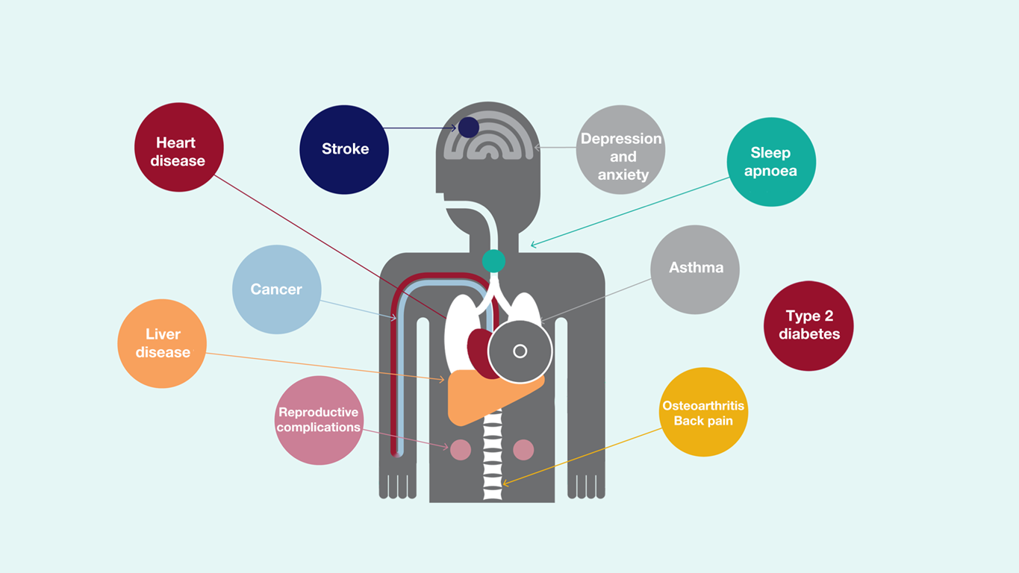

Slide 3
Sugars
Rare Sugar
α
β

Slide 4
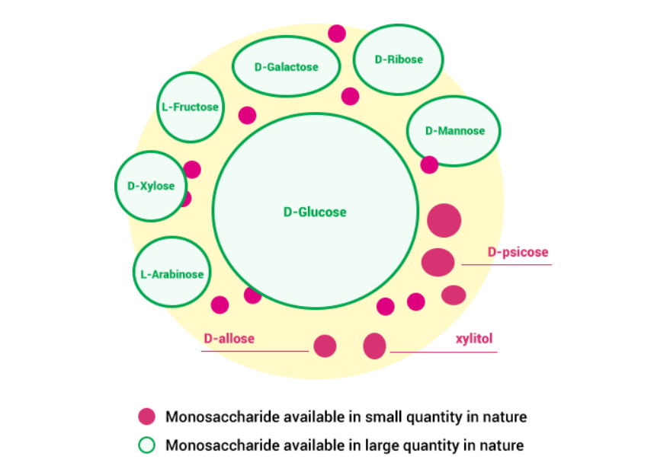
Sugars
Rare Sugar
Rare Sugar Market Value to Cross $1.65 Billion by 2026

Slide 5
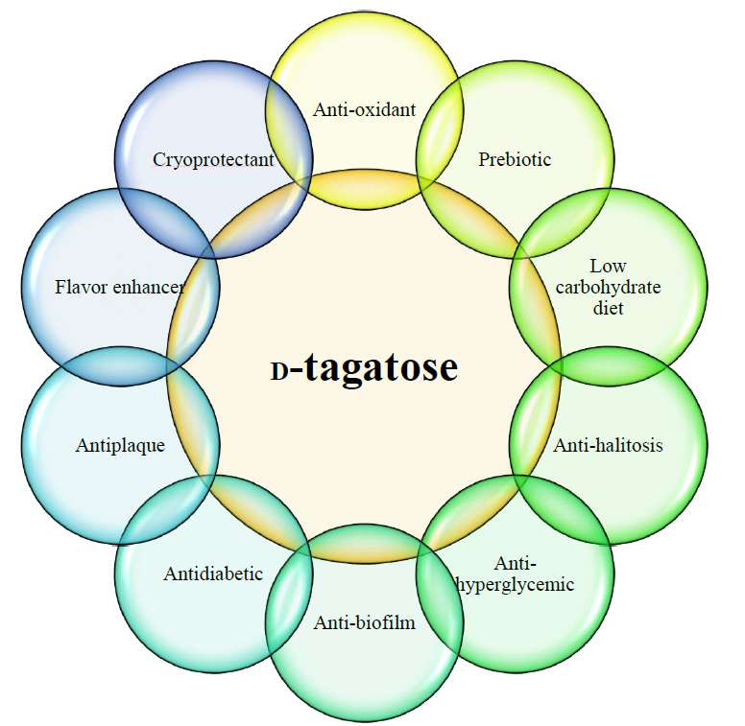
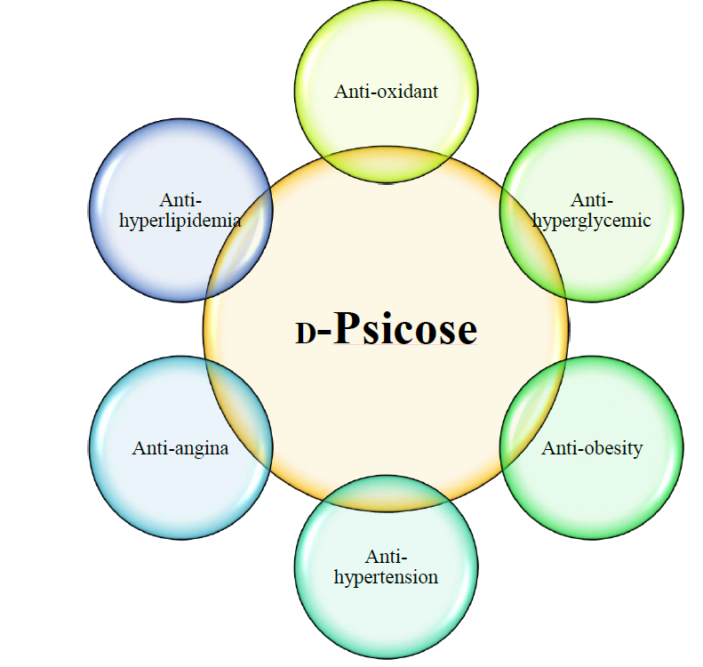
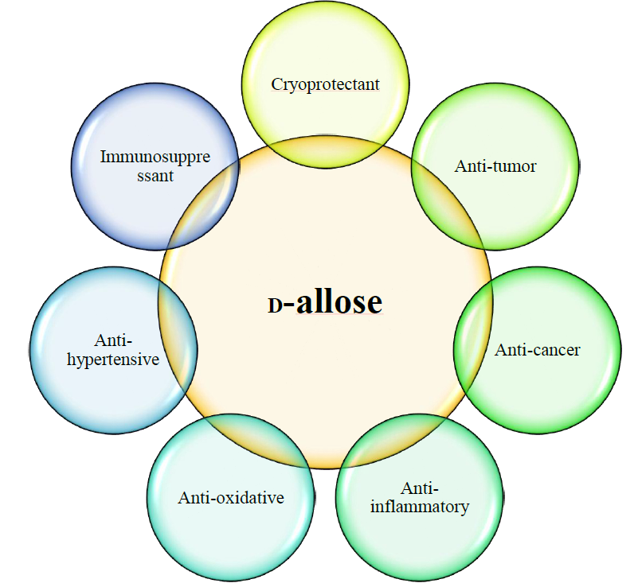
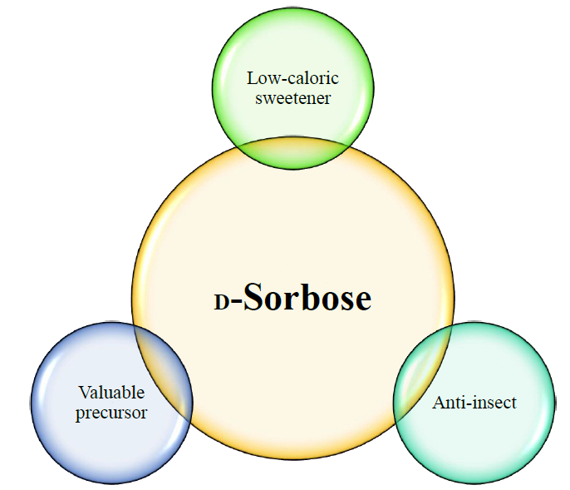

Slide 6
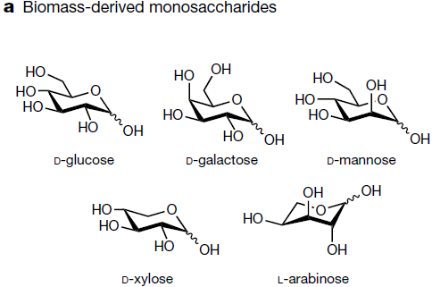
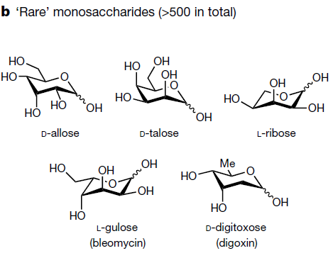
Sugars
Rare Sugar

Slide 7
Biosynthesis strategy for all monosaccharides using Izumoring
Rare Sugar
L
L-Series
D+L
D-Series
LGlu
DGlu
Keto
Keto
LIdi
DMan
D-Tagatose
3-epimerase
DU
LIdo
DGlu
LGlu
LSor
DFru
DMan
Poly
Keto
LGal
Polyol
dehydrogenase
LTal
LTag
DAll
DPsi
DAlt
Gal
LTal
LAlt
All
DTal
DAlt
Aldo
Keto
LAlt
DTal
Aldo
isomerase
LAll
DGal
LPsi
DTag
LMan
DIdo
LFru
DGlu
LGlu
DSor
Poly
Aldo
LMan
DIdi
Aldo
reductase
LGlu
DGlu

Slide 8
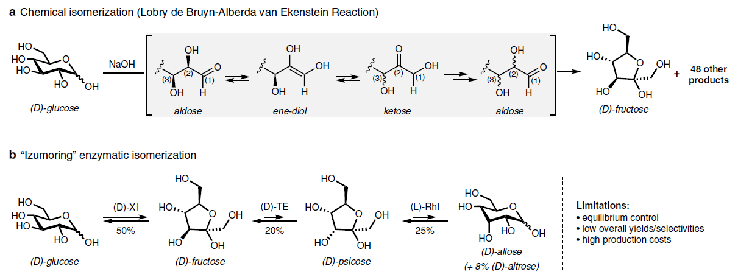
Synthesis of rare sugar using chemical and enzymatic methods
Rare Sugar

Slide 9
Oxidation of unprotected saccharide
Rare Sugar
Robert M. Waymouth. Angew. Chem. Int. Ed. 2010, 49, 9456 –9459

Slide 10
Oxidation of unprotected saccharide
Rare Sugar
Robert M. Waymouth. ACS Catal. 2016, 6, 4653−4659

Slide 11
Oxidation of unprotected saccharide
Rare Sugar
Adriaan J. Minnaard. Angew. Chem. Int. Ed. 2013, 52, 7809 –7812

Slide 12
Oxidation of unprotected saccharide
Rare Sugar
Muramatsu, W. Org. Lett. 2014,16, 4846–4849

Slide 13
Site-selective C–C bond formation in unprotected monosaccharides
Rare Sugar
David W. C. MacMillan, Science, 2015, 349,6255

Slide 14
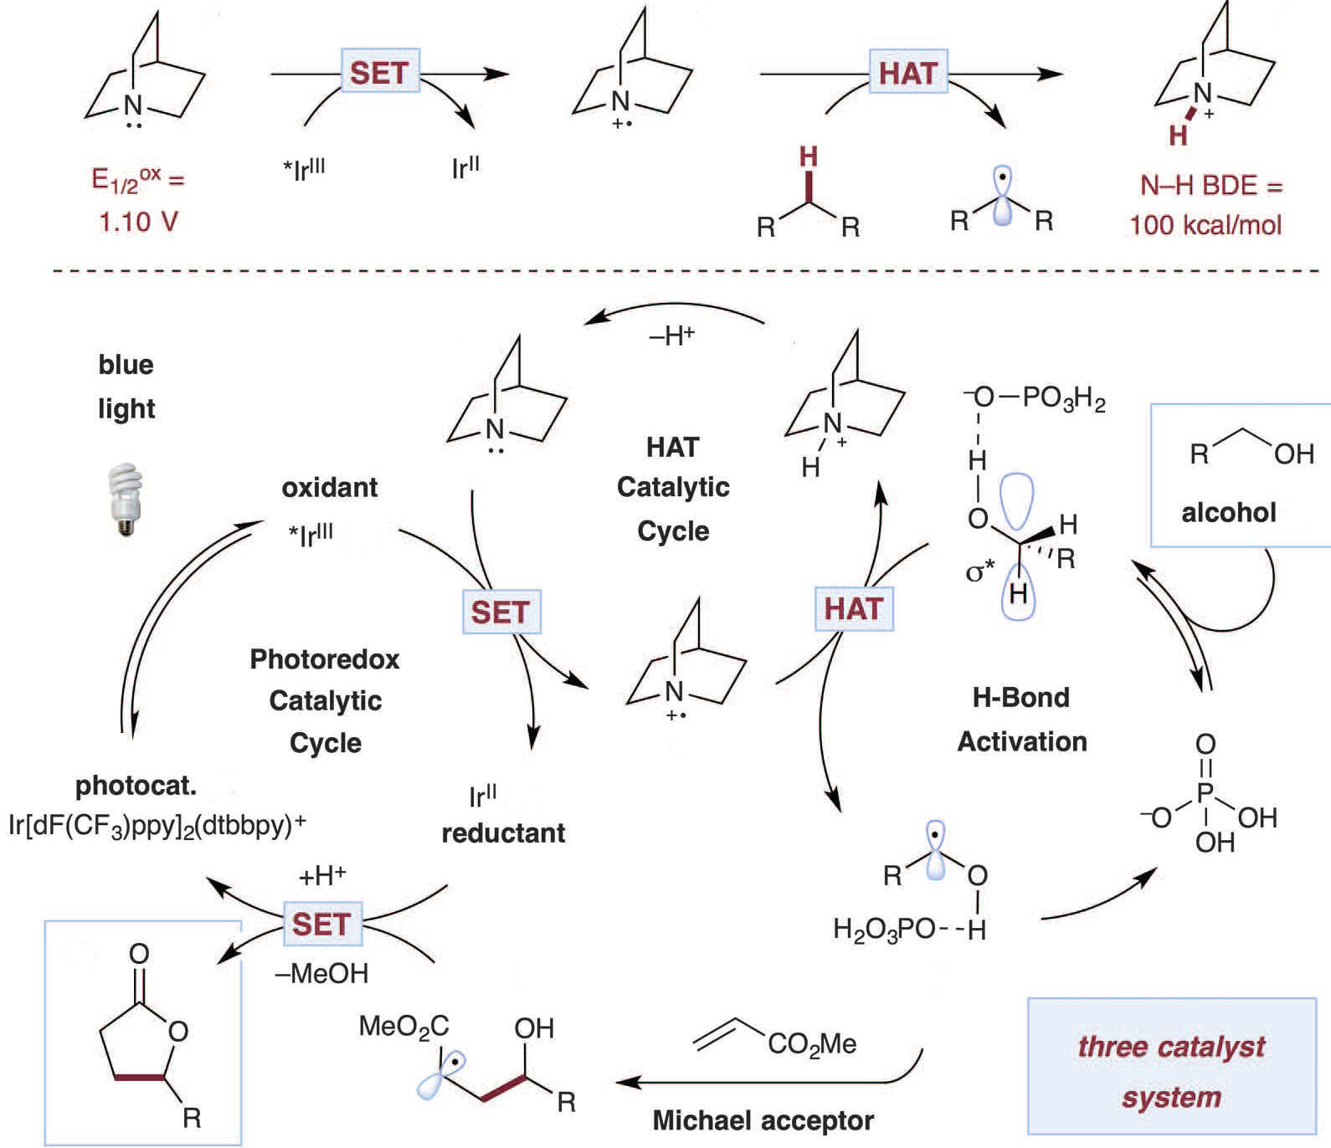
Site-selective C–C bond formation in unprotected monosaccharides
Rare Sugar
David W. C. MacMillan, Science, 2015, 349,6255

Slide 15
Site-selective C–C bond formation in unprotected monosaccharides
Rare Sugar
Adriaan J. Minnaard. Chem. Commun., 2017, 53, 4926--4929

Slide 16
Alison Wendlandt
2018-Present Cecil and Ida Green Career Development,MIT
Assistant Professor
Educational Background:
2015-2018 Harvard University NIH Postdoctoral Fellow Advisor: E. N. Jacobsen 2015 University of Wisconsin – Madison
Ph.D. Chemistry . Advisor: S. S. Stahl 2007 University of Chicago; Biological
B.S. Chemistry. Advisor: S. Kozmin

Slide 17
Synthesis of rare sugar isomers through site-selective epimerization
Rare Sugar
Alison E. Wendlandt. Nature 2020, 578, 403–408

Slide 18
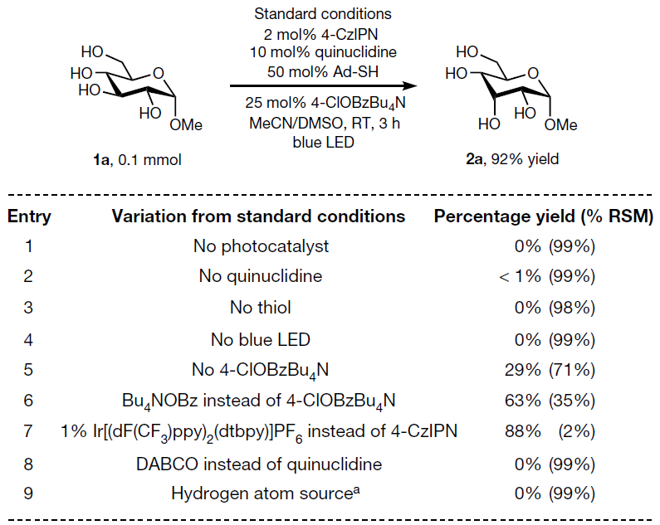
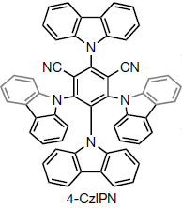
Synthesis of rare sugar isomers through site-selective epimerization
Rare Sugar
Alison E. Wendlandt. Nature 2020, 578, 403–408

Slide 19
Synthesis of rare sugar isomers through site-selective epimerization
Rare Sugar
Alison E. Wendlandt. Nature 2020, 578, 403–408

Slide 20
Synthesis of rare sugar isomers through site-selective epimerization
Rare Sugar
Alison E. Wendlandt. Nature 2020, 578, 403–408

Slide 21
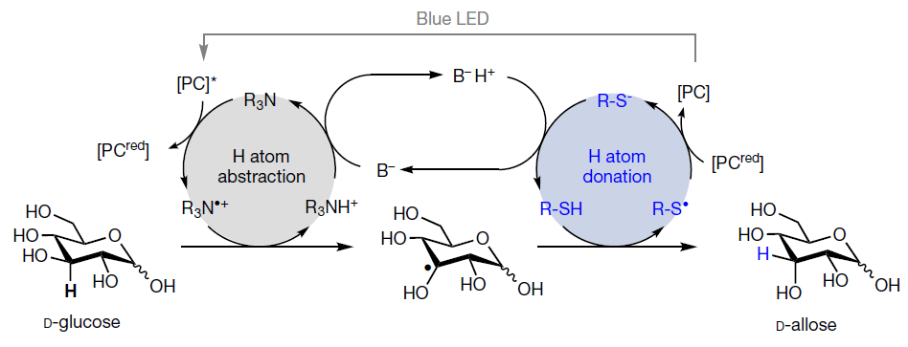
Synthesis of rare sugar isomers through site-selective epimerization
Rare Sugar

Slide 22
THANKS

