Slide 1
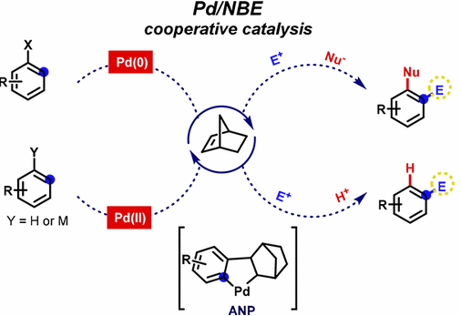
Chemistry of the years
Progress in Palladium/Norbornene Cooperative Catalysis
Yadong Gao
2019-12-28

Slide 2
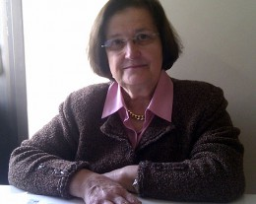
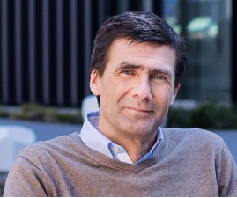
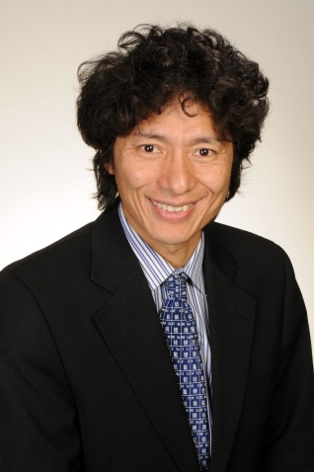
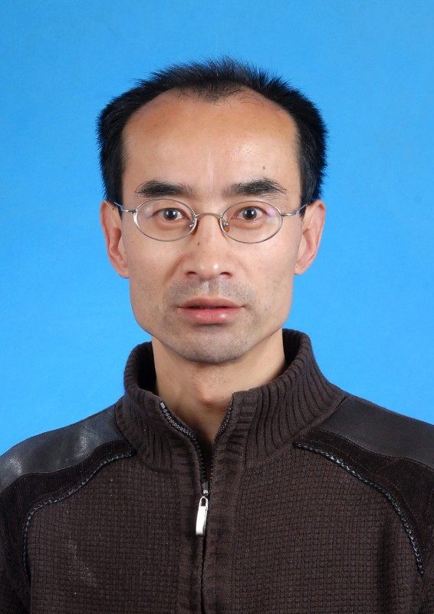
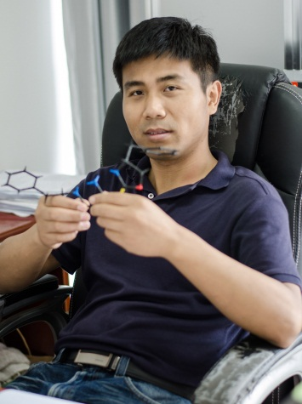
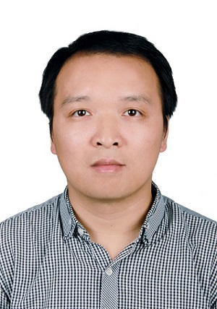
Reviews
1) M. Catellani, Acc. Chem. Res. 2008, 41, 1512-1522.
2) M. Lautens, Top. Curr. Chem. 2010, 292, 1-33.
3) R. Ferraccioli, Synthesis 2013, 581-591.
4) Z. Chen, Chin. J. Org. Chem. 2015, 35, 2291-2300.
5) M. Lautens, Nat. Chem. 2015, 7, 863-870.
6) M. Catellani, Acc. Chem. Res. 2016, 49, 1389-1400.
7) H. Jun, Chem. Rev. 2017, 117, 8977-9015.
8) I. Marek, Nat. Rev. Chem. 2017, 1, 0035.
9) L. Ackermann, Chem, 2018, 4, 199-222.
10) Q. Zhou, Chem. Eur. J. 2018, 24, 15461-15476.
11) T. Bach, Org. Biomol. Chem. 2018, 16, 5376-5385.
12) Q. Zhou, Angew. Chem. Int. Ed. 2019, 58, 5832-5844.
13) G. Dong, Chem. Rev. 2019, 119, 7478-7528.
Zhiyuan Chen

Slide 3
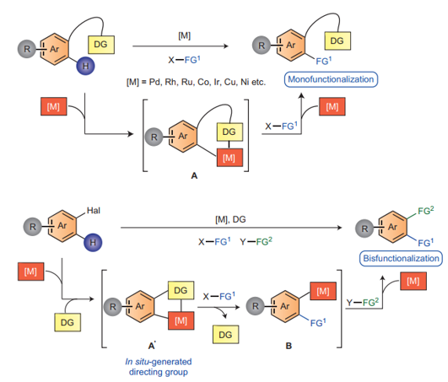
C-H functionalization with directing group
Bisfunctionalization with in situ-generated directing group
J. Ye, M. Lautens, Nat. Chem. 2015, 7, 863-870.

Slide 4
Catellani reaction and mechanism
Catellani M, Angew. Chem. Int. Ed. 1997, 36, 119-122.

Slide 5
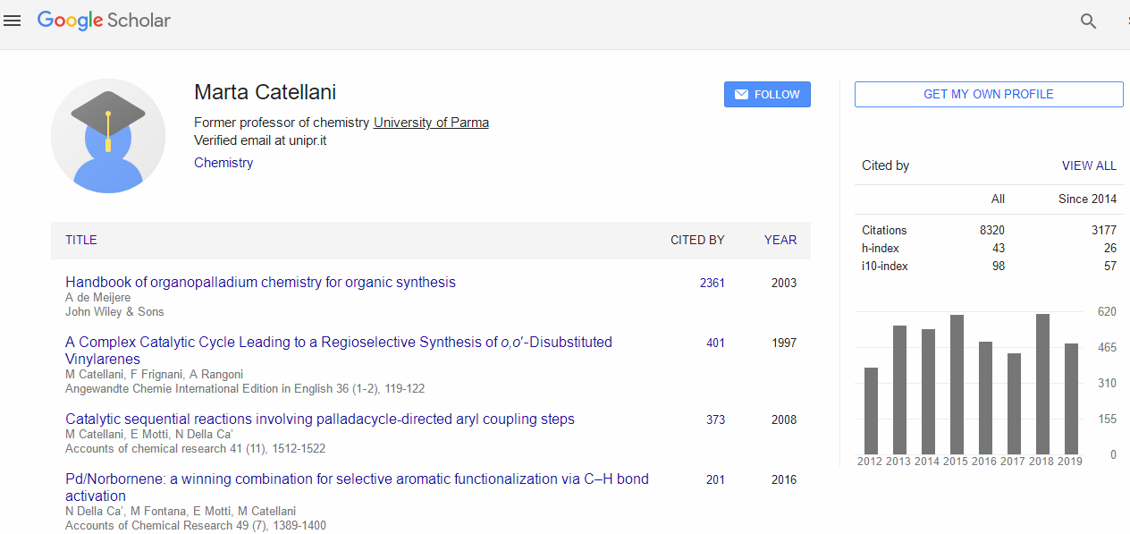
https://scholar.google.com/citations?hl=zh-CN&user=wnEDuAcAAAAJ

Slide 6
Pd(0)/NBE catalyzed functionalization of aryl halides
to be continued

Slide 7
Pd(0)/NBE catalyzed functionalization of aryl halides
continued

Slide 8
Catellani reaction
Catellani-Lautens reaction
Catellani M, Angrew. Chem. Int. Ed. 1997, 36, 119-122.
Lautens M, Angrew. Chem. Int. Ed. 2000, 39, 1045-1046.

Slide 9
Pd(0)/NBE catalyzed functionalization of aryl halides
to be continued

Slide 10
Pd(0)/NBE catalyzed functionalization of aryl halides
continued

Slide 11
Total synthesis using Pd/NBE cooperative catalysis

Slide 12
NBE-byproduct in Catellani reaction

Slide 13
Diverse NBE-structures synthesis

Slide 14
Pd(II)/NBE catalyzed functionalization of indoles
L. Jiao, T. Bach, J. Am. Chem. Soc. 2011, 133, 12990-12993.
L. Jiao, T. Bach, Angew. Chem. Int. Ed. 2013, 52, 6080-6083.
L. Jiao, E. Herdtweck, T. Bach, J. Org. Chem. 2012, 134, 14563-14572.
F. Xue, C. Jiang, Tetrahedron Lett. 2017, 58, 2213-2216.
G. Liu, ACS Catal. 2018, 8, 2173-2180.
T. Bach, Synthesis 2019

Slide 15
Mechanism of Pd(II)/NBE catalyzed C2-functionalization of indoles
L. Jiao, E. Herdtweck, T. Bach, J. Am. Chem. Soc. 2012, 134, 14563-14572.

Slide 16
Pd(II)/NBE catalyzed meta-functionalization of arenes
J.-Q. Yu, Nature 2015, 519, 334-338.
G. Dong, J. Am. Chem. Soc. 2015, 137, 5887-5890.
J.-Q. Yu, Nature, 2018, 558, 581-585.

Slide 17
Mechanism of Pd(II)/NBE catalyzed meta-functionalization of arenes

Slide 18
Pd(II)/NBE catalyzed functionalization of aryl borons
Y. Zhang, ACS Catal. 2018, 8, 3775−3779.
Q. Zhou, Angew. Chem. Int. Ed. 2018, 57, 7161-7165.
G. Dong, Chem, 2019, 5, 929-939.
Q. Zhou, Org. Lett. 2019, 21, 3323-3327.
Q. Zhou, Chem. Sci. 2019, 10, 8384-8389.

Slide 19
Mechanism of Pd(II)/NBE catalyzed functionalization of aryl borons

Slide 20
Recent progress in Pd/NBE cooperative catalysis

Slide 21
Electrophile reagents in Catellani reaction
Org. Lett. 2019, 21, 9, 3204-3209

Slide 22
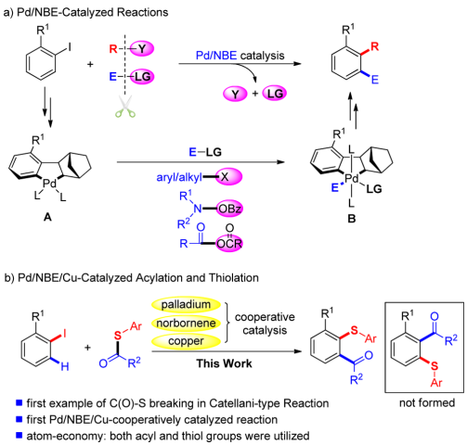
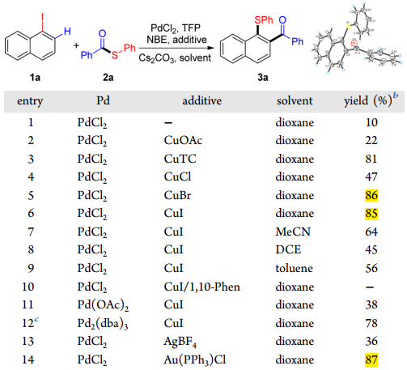
J. Am. Chem. Soc. 2016, 138, 7456-7459

Slide 23
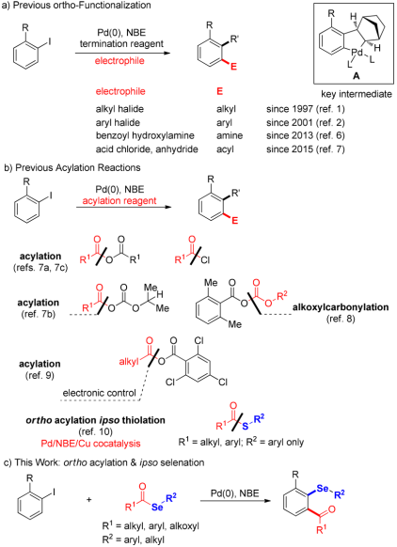
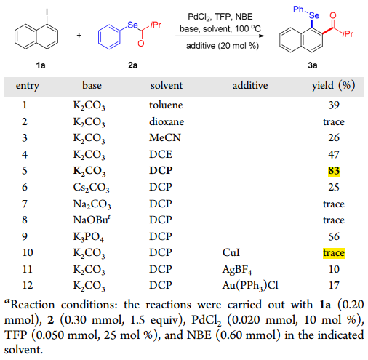
Org. Lett. 2018, 20, 1187-1190

Slide 24
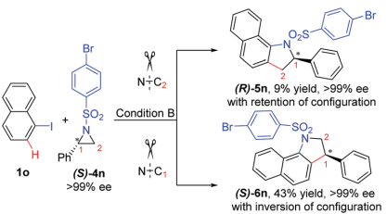
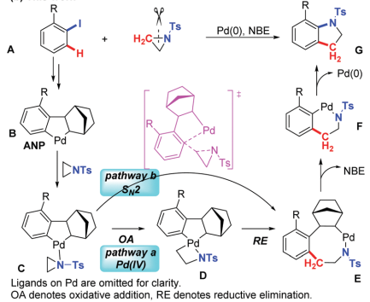
Chem. Commun. 2018, 54, 3407-3410

Slide 25
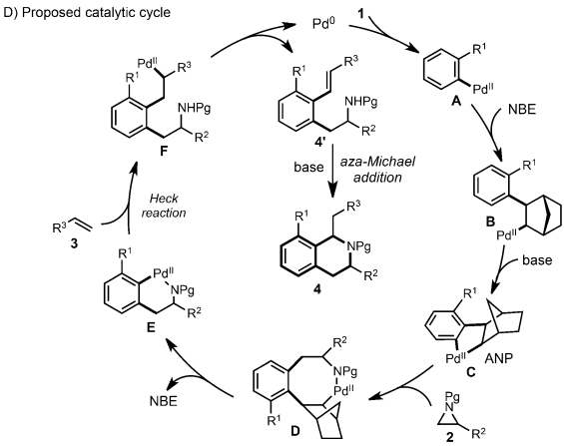
Angew. Chem. Int. Ed. 2018, 57, 10980 –10984

Slide 26
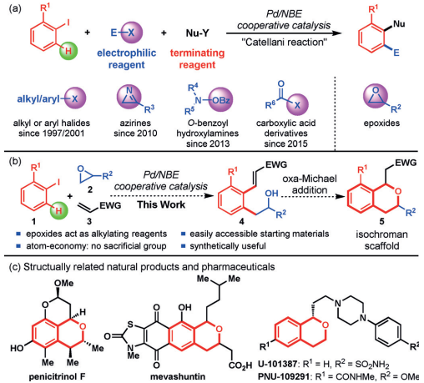
Angew. Chem. Int. Ed. 2018, 57, 3444-3448

Slide 27
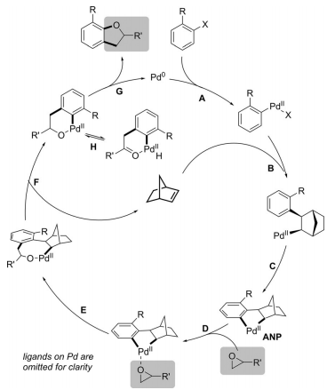
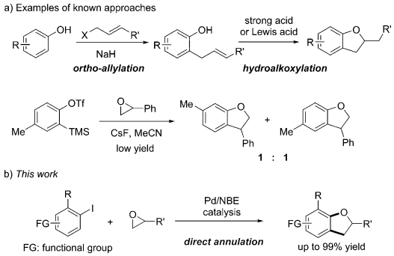
Angew. Chem. Int. Ed. 2018, 57, 1697-1701

Slide 28
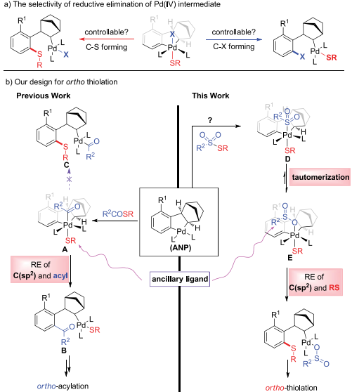
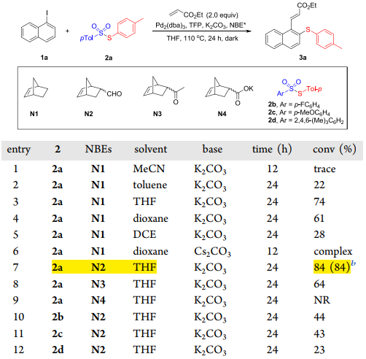
Org. Lett. 2019, 21, 3204-3209

Slide 29
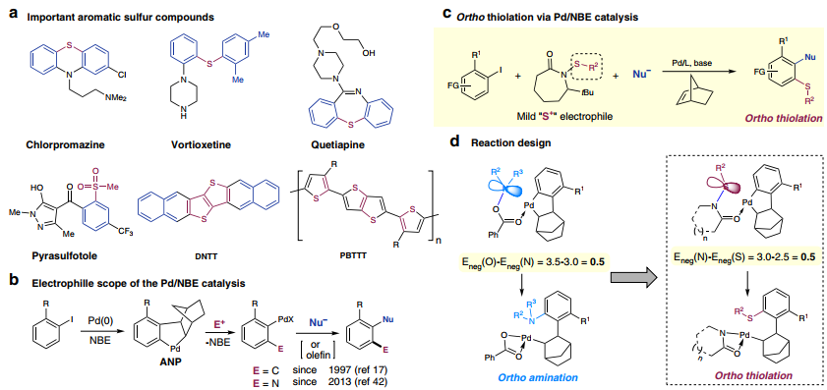
Nature communications, 2019, 10, 3555.

Slide 30
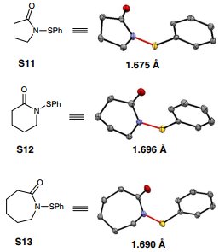
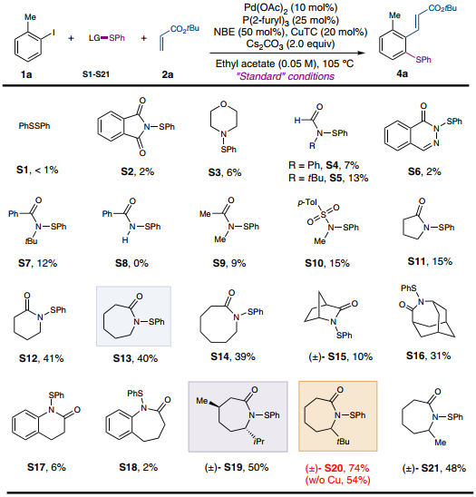
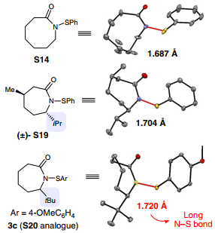
Nature communications, 2019, 10, 3555.

Slide 31
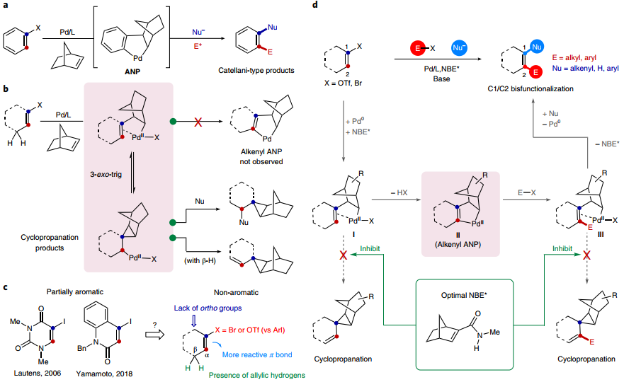
Nature chemistry, 2019, 11, 1106-1112.

Slide 32
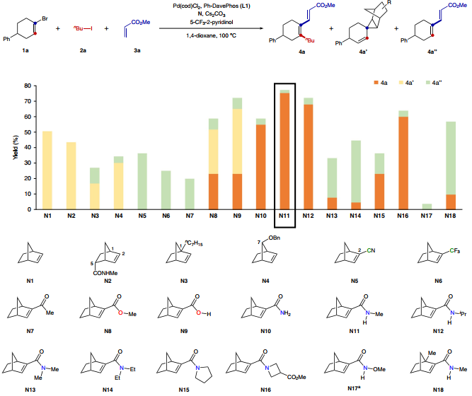
Nature chemistry, 2019, 11, 1106-1112.

Slide 33
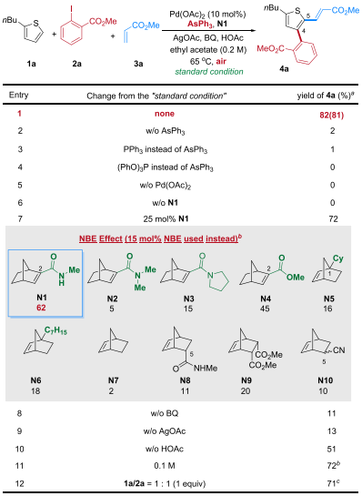
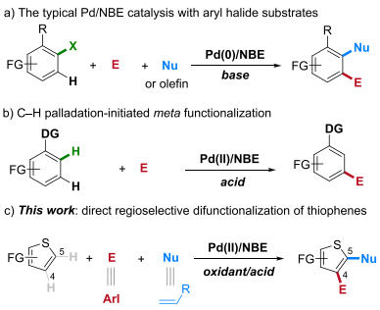
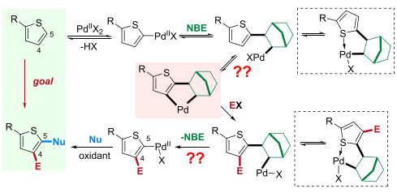
J. Am. Chem. Soc. 2019, 141, 18958-18963

Slide 34
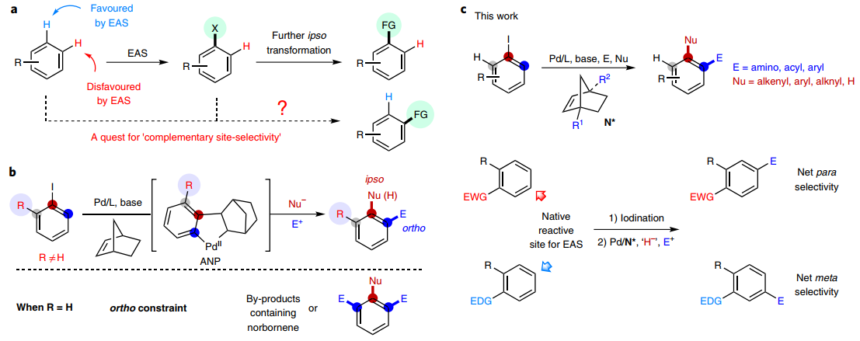
Nature chemistry, 2018, 10(8): 866.

Slide 35
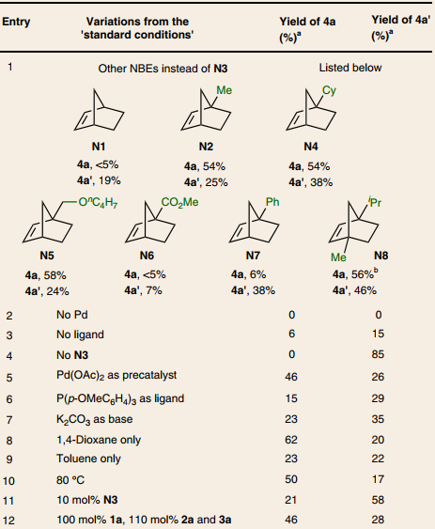
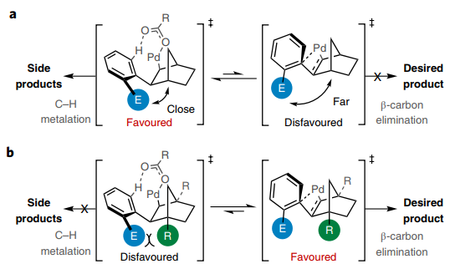
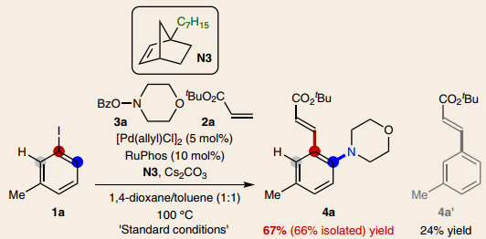
Nature chemistry, 2018, 10(8): 866.

Slide 36
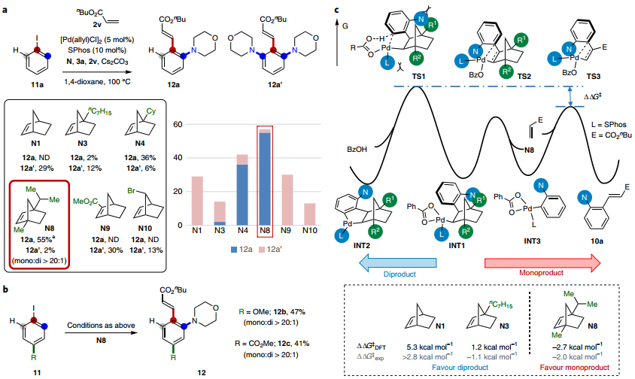
Nature chemistry, 2018, 10(8): 866.

Slide 37
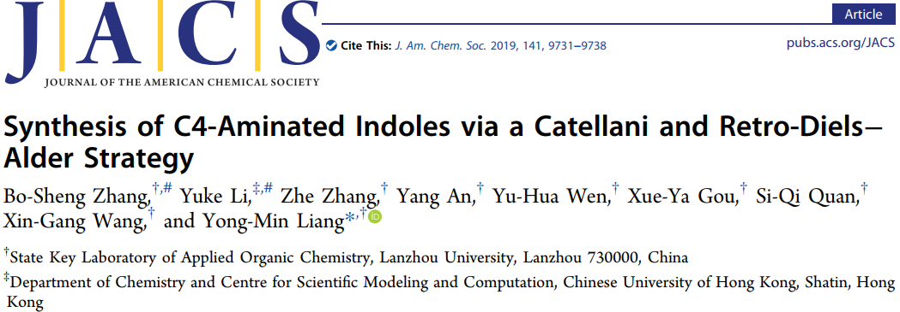
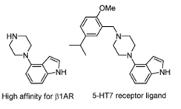
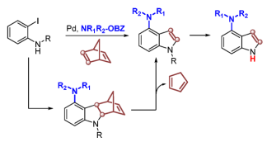
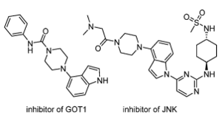
J. Am. Chem. Soc. 2019, 141, 9731-9738

Slide 38
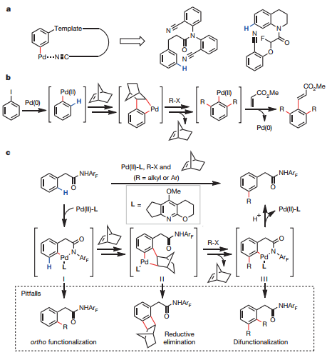
Nature, 2015, 519, 334.

Slide 39
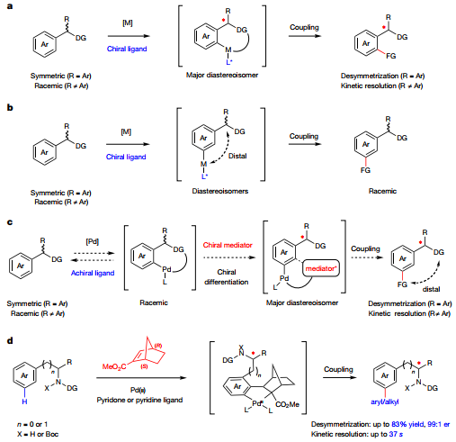
Nature, 2018, 558, 581

Slide 40
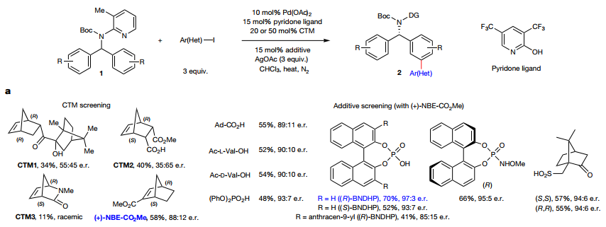
Nature, 2018, 558, 581

Slide 41
Thanks

