Slide 1
Hubei Key Laboratory of Natural Medicinal Chemistry and Resource Evaluation, School of Pharmacy, Huazhong University of Science and Technology 13 Hangkong Road, Wuhan, Hubei, 430030, China.

Slide 2
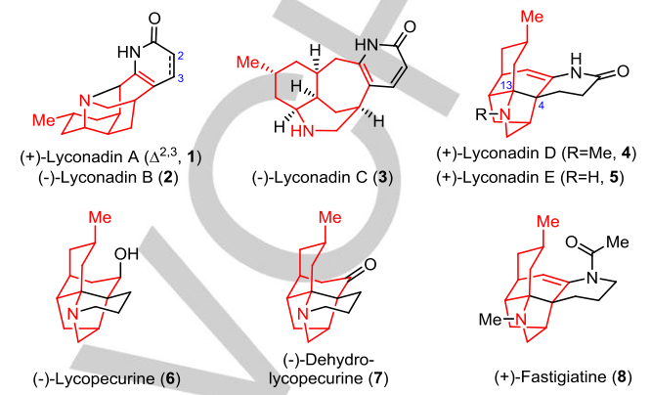
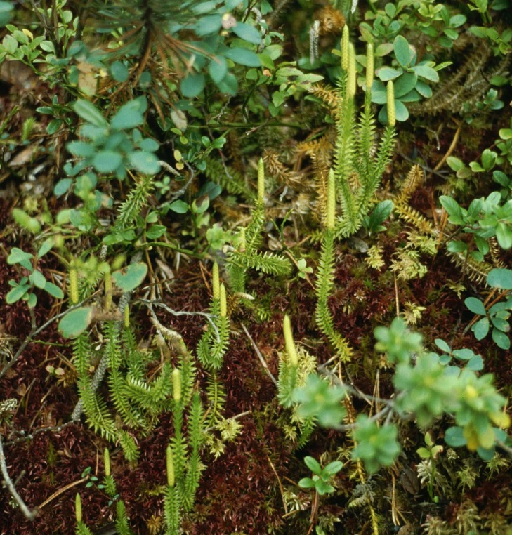
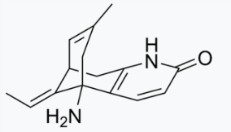
Lycopodium alkaloids石松属生物碱
More than 300 alkaloids isolated from 54 Lycopodium species (石松属).
石松全草人药，有舒筋活血、祛风散寒、利尿、通经等药效．药理实验表明，石松超临界提取物具有显著的抗炎镇痛作用，且毒性低；孢子粉广泛应用于农业果树人工授粉，医药业制造药物包衣、婴幼儿爽身粉等，石松四季常青，枝叶奇特美观，是重要观赏蕨类植物之一.
Lycopodium alkaloids like huperzine A could inhibit acetylcholinesterase, improve efficiency for learning and memory in animals, and therefore show potential in treatment of Alzheimer’s disease. In addition, lyconadin A exhibited micromolar cytotoxicity against murine lymphoma L1210 and human epidermoid carcinoma KB cells, while lyconadins A-B could enhance the mRNA expression for nerve growth factor in 1321N1 human astrocytoma cells.
Huperzine A

Slide 3
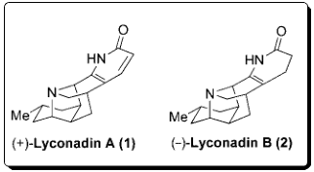
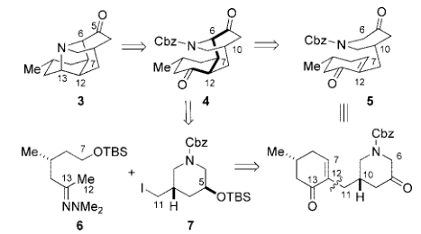
Lycopodium alkaloids—Smith
J. Am. Chem. Soc. 2007, 129, 4148–4149.
J. Am. Chem. Soc. 2008, 130, 13778–13789.

Slide 4
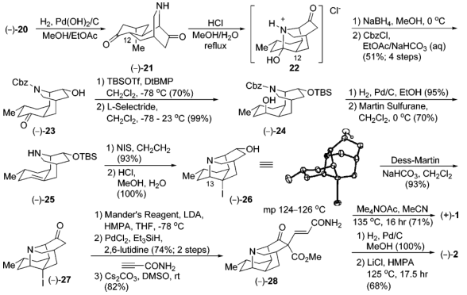
Lycopodium alkaloids—Smith
J. Am. Chem. Soc. 2007, 129, 4148–4149.
J. Am. Chem. Soc. 2008, 130, 13778–13789.

Slide 5
Lycopodium alkaloids—Smith
HCl, DMSO
70 °C
Mander’s reagent
J. Am. Chem. Soc. 2007, 129, 4148–4149.
J. Am. Chem. Soc. 2008, 130, 13778–13789.

Slide 6
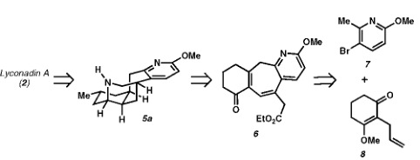
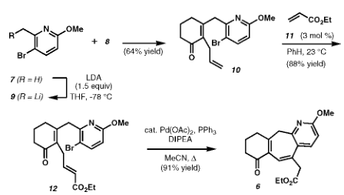
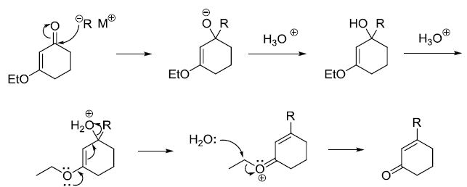
Lycopodium alkaloids—Sarpong
J. Am.Chem. Soc. 2008, 130, 7222–7223.
J. Am. Chem. Soc. 2009, 131, 11187–11194
Stork-Danheiser Reaction

Slide 7
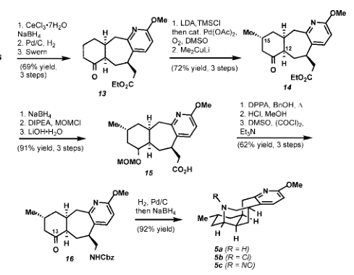
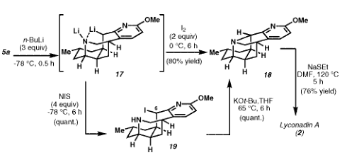
Lycopodium alkaloids—Sarpong
NaBH4
2008
2009

Slide 8
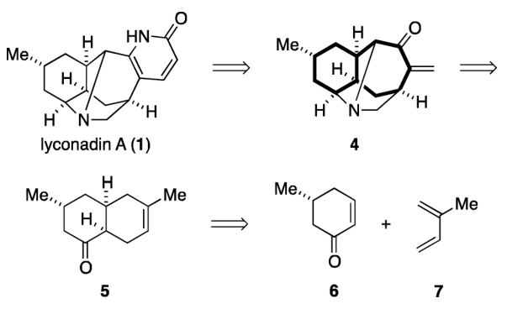
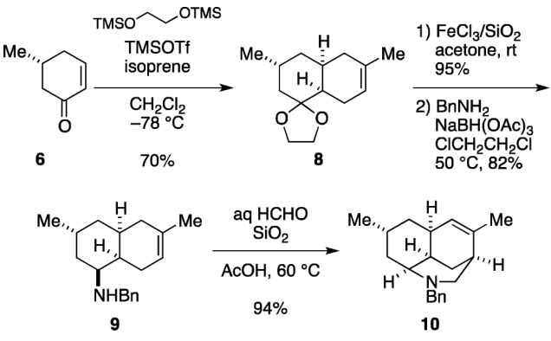
Lycopodium alkaloids—Fukuyama
J. Am. Chem.Soc. 2011, 133, 418-419
J. Am. Chem. Soc. 2013, 135, 3243–3247

Slide 9
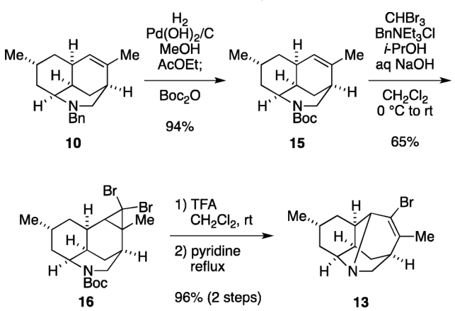
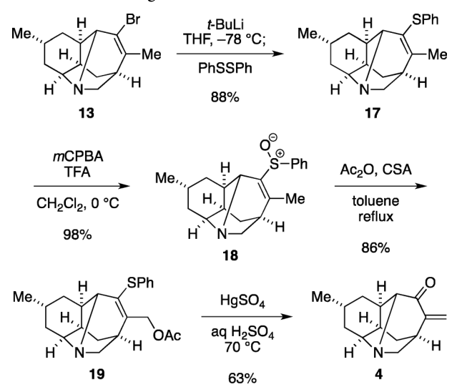
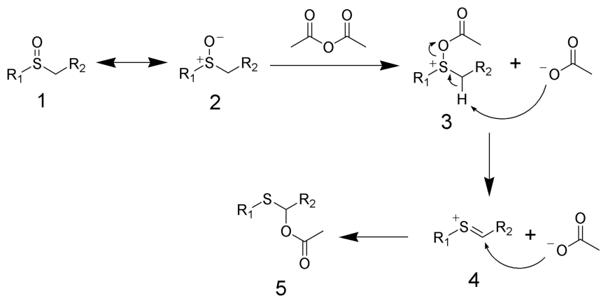
Lycopodium alkaloids—Fukuyama
J. Am. Chem.Soc. 2011, 133, 418-419
J. Am. Chem. Soc. 2013, 135, 3243–3247
Pummerer rearrangement

Slide 10
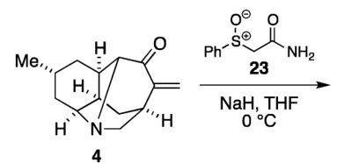
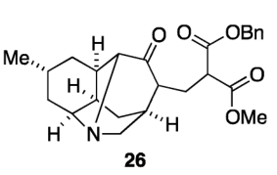
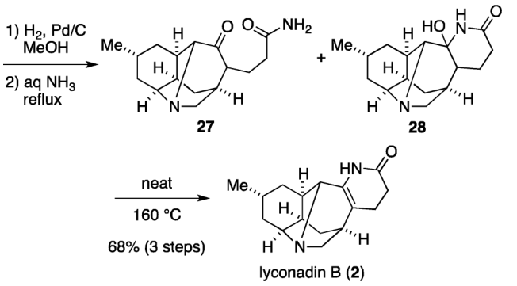
Lycopodium alkaloids—Fukuyama
BnOOCCH2CO2Me
NaH, THF

Slide 11
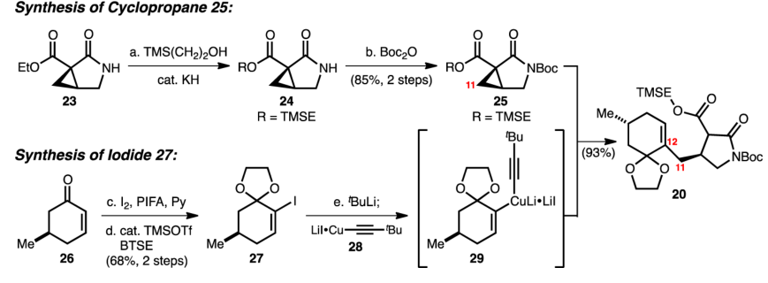
Lycopodium alkaloids— Shair
J. Am. Chem. Soc. 2010, 132, 9594–9595
J. Am. Chem. Soc. 2014, 136, 13442–13452.

Slide 12
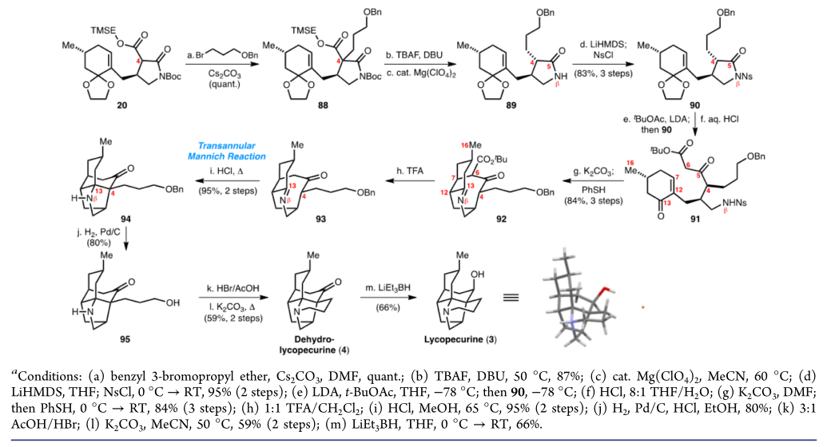
Lycopodium alkaloids— Shair

Slide 13
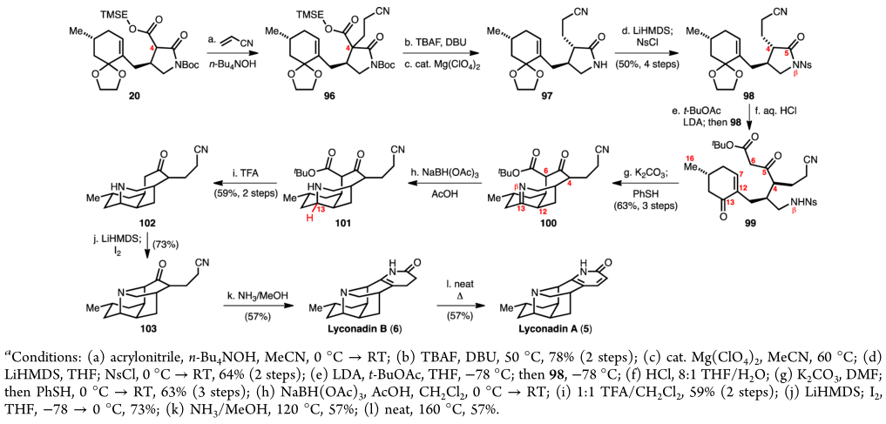
Lycopodium alkaloids— Shair

Slide 14
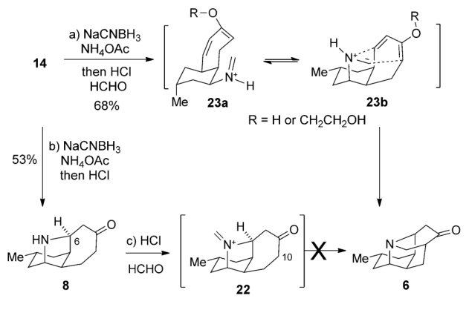
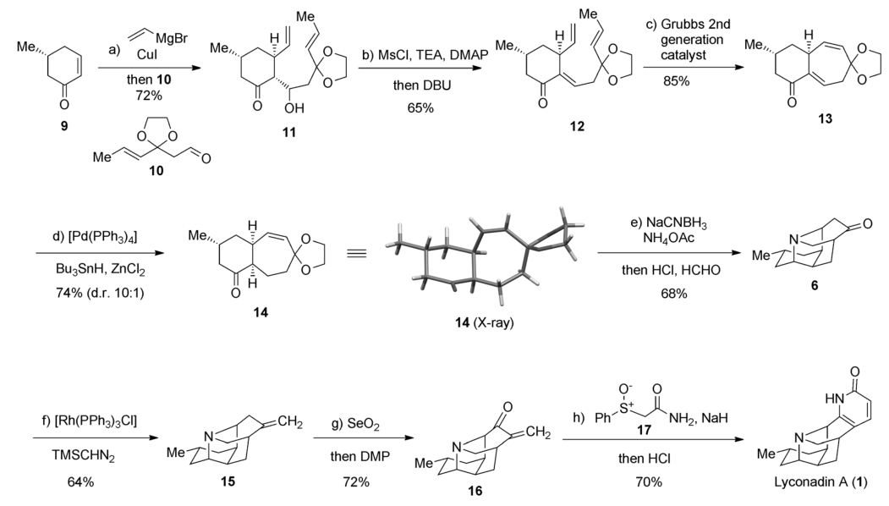
Lycopodium alkaloids— Dai
Angew. Chem. Int. Ed. 2014, 53, 3922–3925

Slide 15
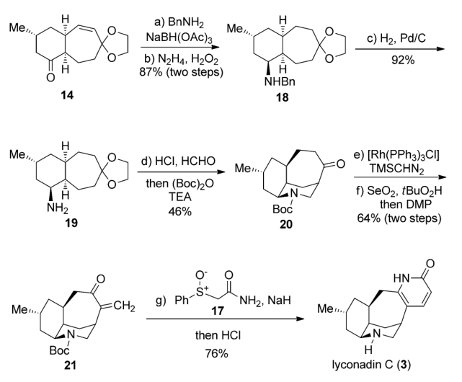
Lycopodium alkaloids— Dai

Slide 16
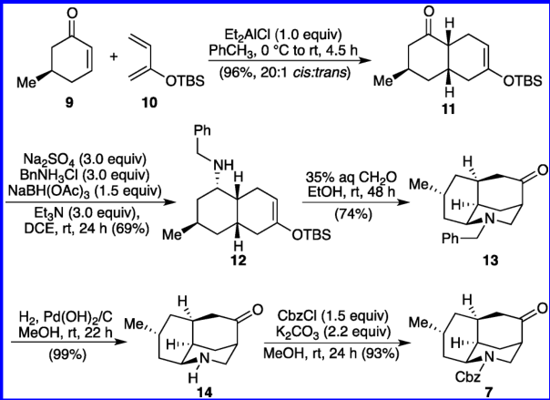
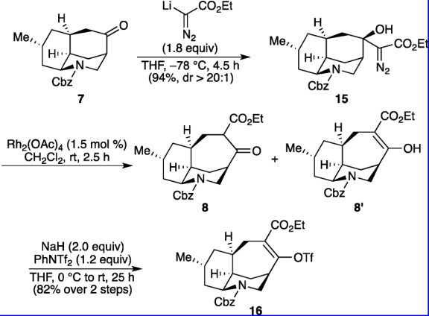
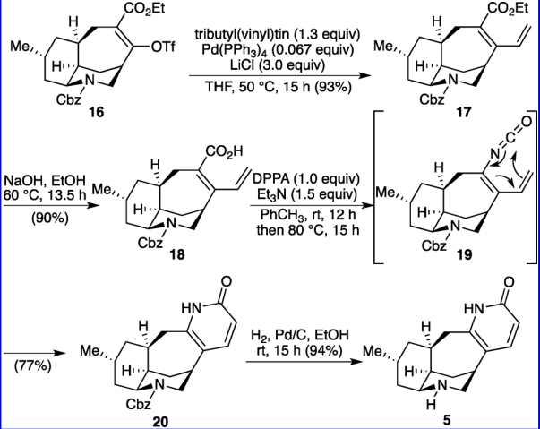
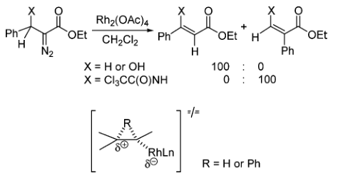
Lycopodium alkaloids— Waters
Org. Lett. 2013, 15, 4226–4229
J. Org. Chem. 2006, 71, 5789-5791

Slide 17
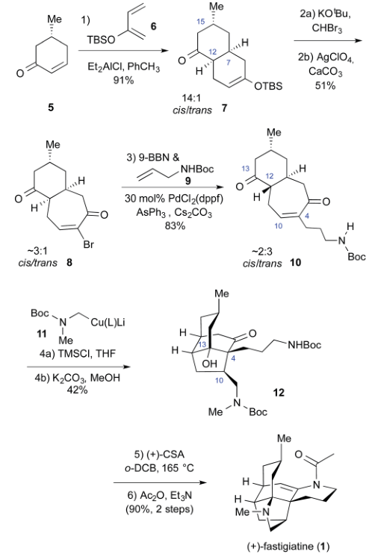
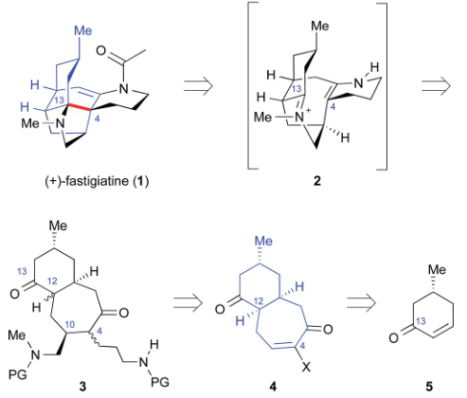
Lycopodium alkaloids— Rychnovsky
Chem. Sci., 2016, 7, 188–190

Slide 18
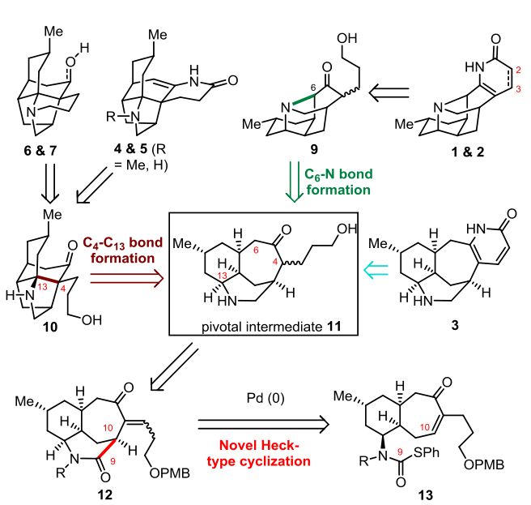
Lycopodium alkaloids

Slide 19
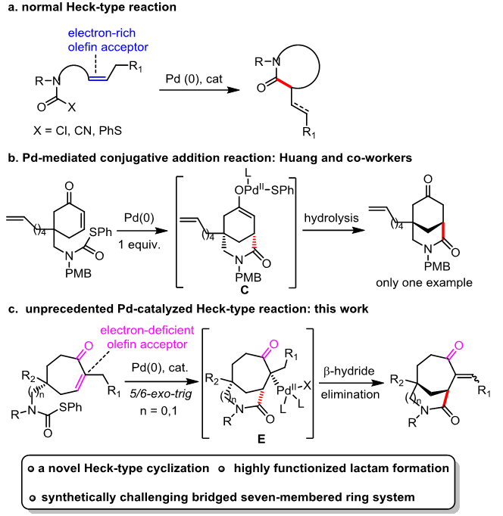
Lycopodium alkaloids--Yang

Slide 20
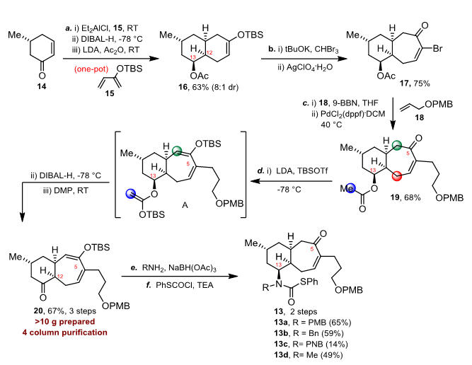
Lycopodium alkaloids--Yang

Slide 21
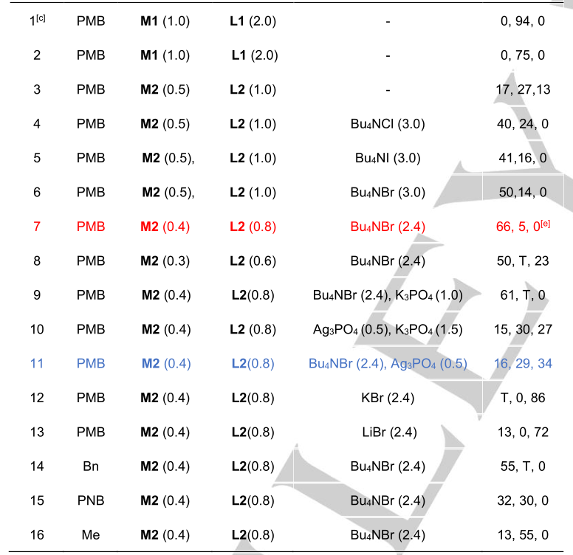
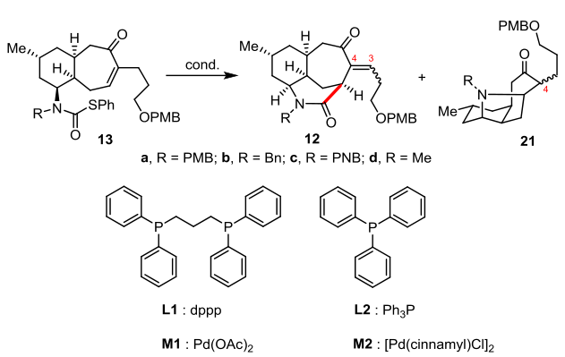
Lycopodium alkaloids--Yang

Slide 22
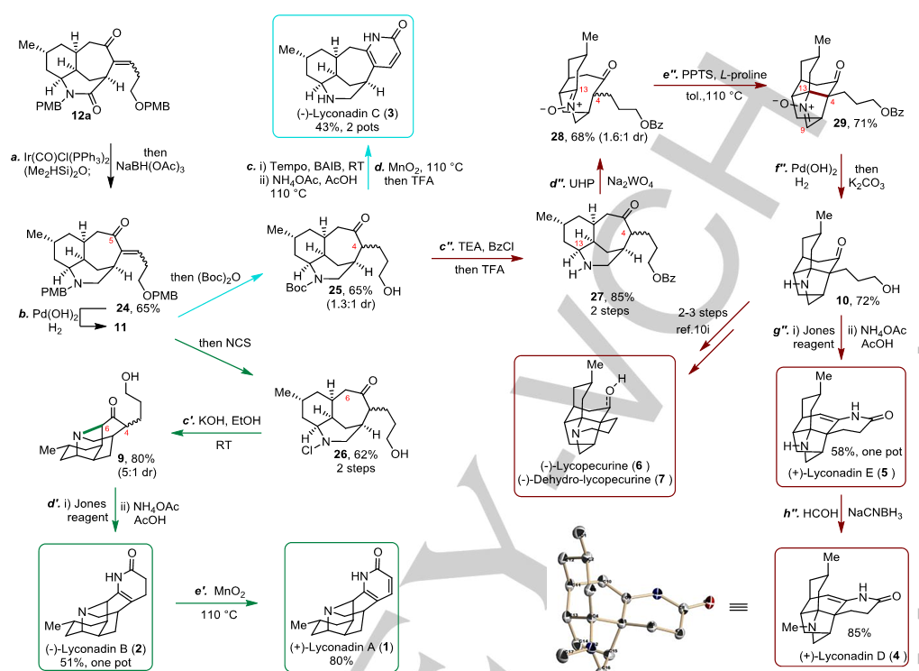
Lycopodium alkaloids--Yang

Slide 23
Thanks

