Slide 1
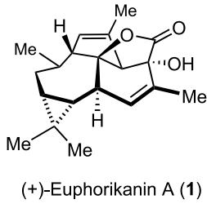
Enantioselective Total Synthesis of (+)-Euphorikanin A Erick M. Carreira Eidgenössiche Technische Hochschule Zürich
J. Am. Chem. Soc. 2021
Publication Date:May 27, 2021

Slide 2
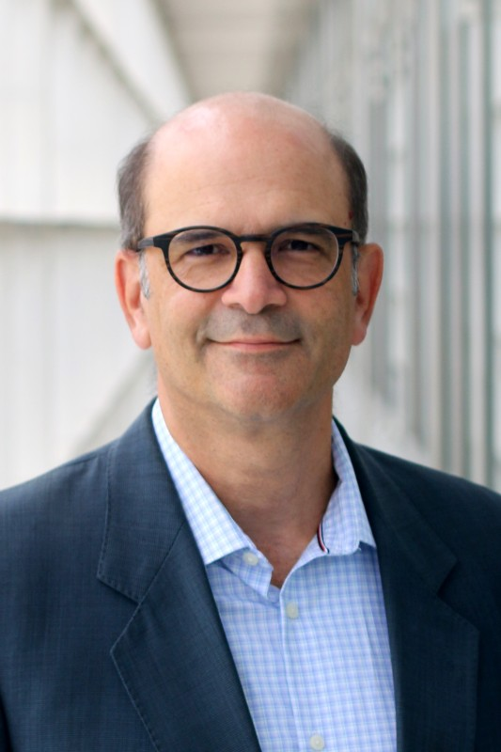
Introduction- Erick M. Carreira
Education:
-1984 B.S., UIUC, Scott E. Denmark;
1984-1992 PhD & work, Harvard, David A. Evans;
1992–1997 Postdoctoral, Assistant Professor & full Professor, Caltech, Peter B. Dervan;
1998– Full professor, ETH Zürich;
Career:
2001-2019 Associate Editor of Organic Letters;
2019- Editor-in-Chief of Organic Letters;
2020- Editor-in-Chief of Journal of the American Chemical Society
Research:
Carreira's group focuses on asymmetric total synthesis of complex natural products. And the applications of these methods to development of catalysts and to medicinal chemistry.

Slide 3
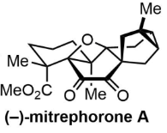
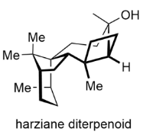
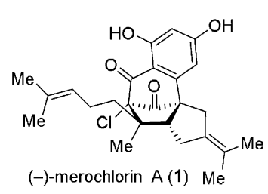
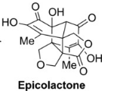
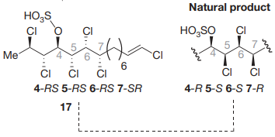
Introduction- Erick M. Carreira
JACS 2021
JACS 2020
ACIE 2020
ACIE 2019
ACIE 2018
Nature 2009,
JACS 2019 (Mytilipin B-revised)

Slide 4
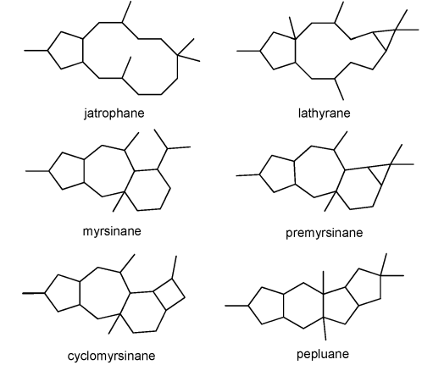
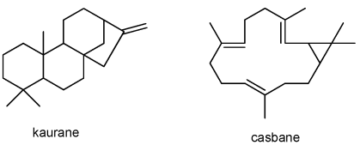
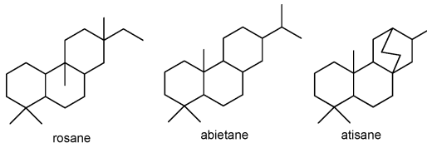
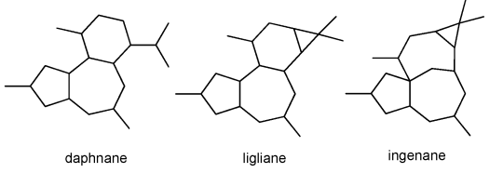
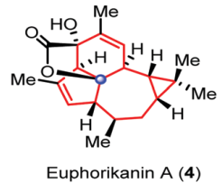
Introduction- Euphorbia Diterpenes
Skeletal types of Euphorbia diterpenes
More than 871 compounds (2012)
Org. Lett. 2016
Judit Hohmann Chem. Rev. 2014, 114, 8579
Zhan-Xin Zhang Org. Lett. 2016, 18, 12, 2844
Org. Lett. 2016

Slide 5
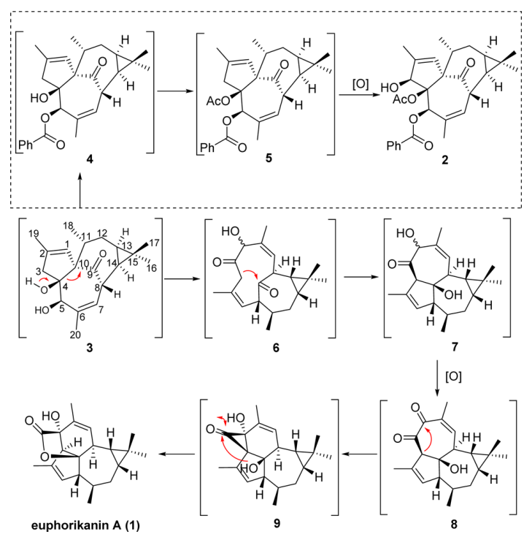
Proposed biosynthesis of Euphorikanin A

Slide 6
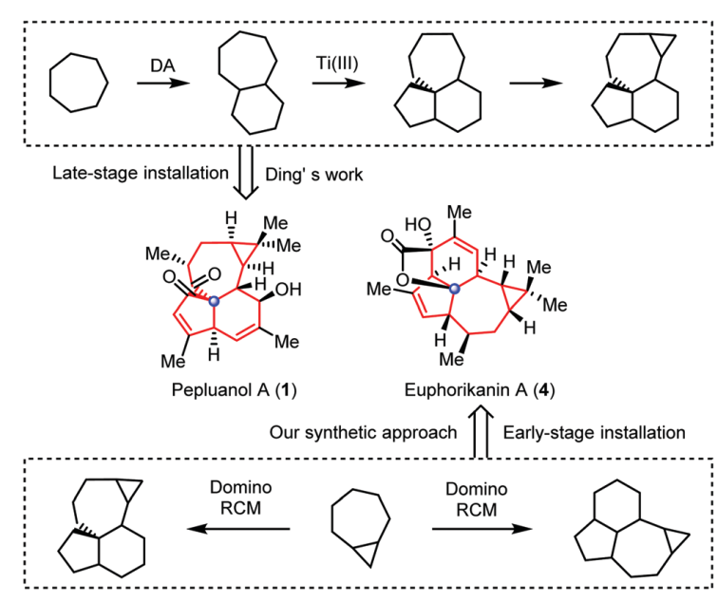
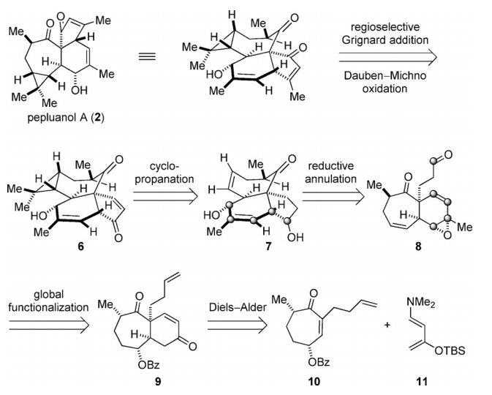
Synthesis of Euphorikanin A skeleton
Retrosynthetic Analysis
H. Ding, Angew. Chem., Int. Ed., 2017, 56, 8898

Slide 7
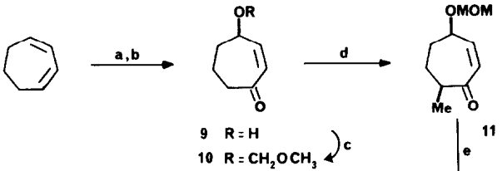
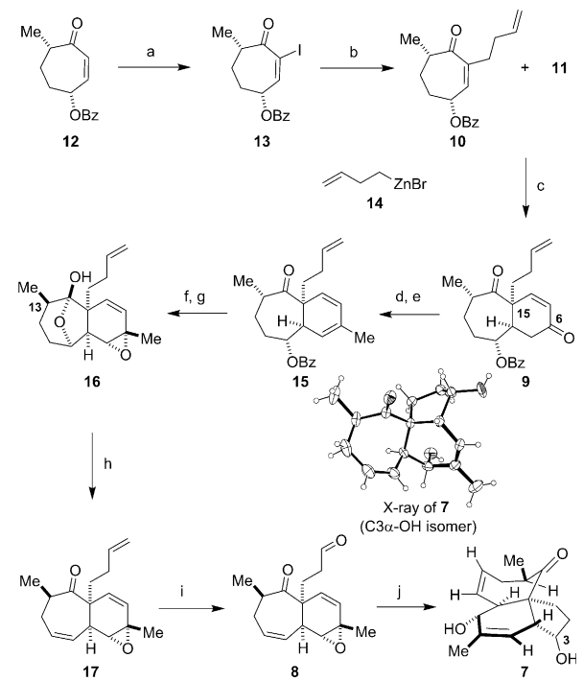
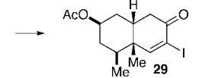
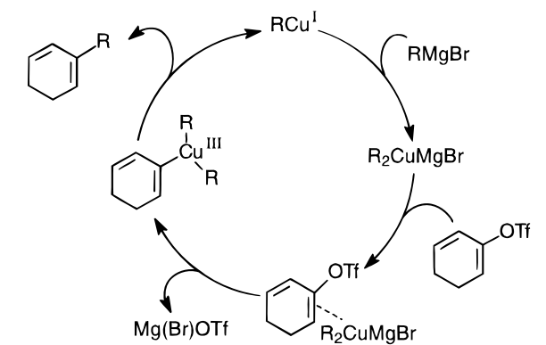
Synthesis of Euphorikanin A skeleton
Synthesis of Pepluanol A by Hanfeng Ding
14, Negishi
Diels–Alder
f) NaOMe
g) DMDO
d)KHMDS, PhNTf2,
e) CuI, MeMgBr
Mitsunobu
The Nugent Reagent
H. Ding, Angew. Chem., Int. Ed., 2017, 56, 8898

Slide 8
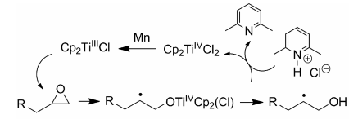
Synthesis of Euphorikanin A skeleton
Synthesis of Pepluanol A by Hanfeng Ding
14, Negishi
Diels–Alder
f) NaOMe
g) DMDO
Mitsunobu
Org. Lett. 1999, 1, 4, 607
The Nugent Reagent
H. Ding, Angew. Chem., Int. Ed., 2017, 56, 8898

Slide 9
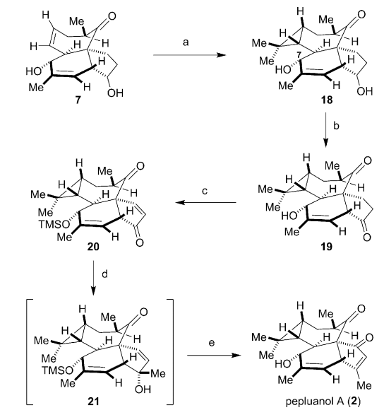
Synthesis of Euphorikanin A skeleton
Synthesis of Pepluanol A by Hanfeng Ding
Babler-Dauben oxidation (tertiary allylic alcohols)
TEMPO/NCS
Saegusa oxidation
PCC
H. Ding, Angew. Chem., Int. Ed., 2017, 56, 8898

Slide 10
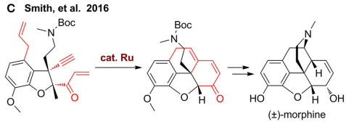
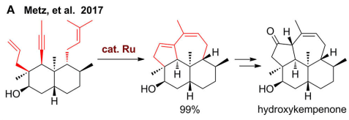
Synthesis of Euphorikanin A skeleton
Retrosynthetic Analysis
Enyne metathesis
Zhen Yang Chem. Commun., 2020, 56, 531

Slide 11
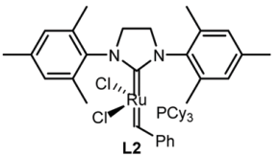
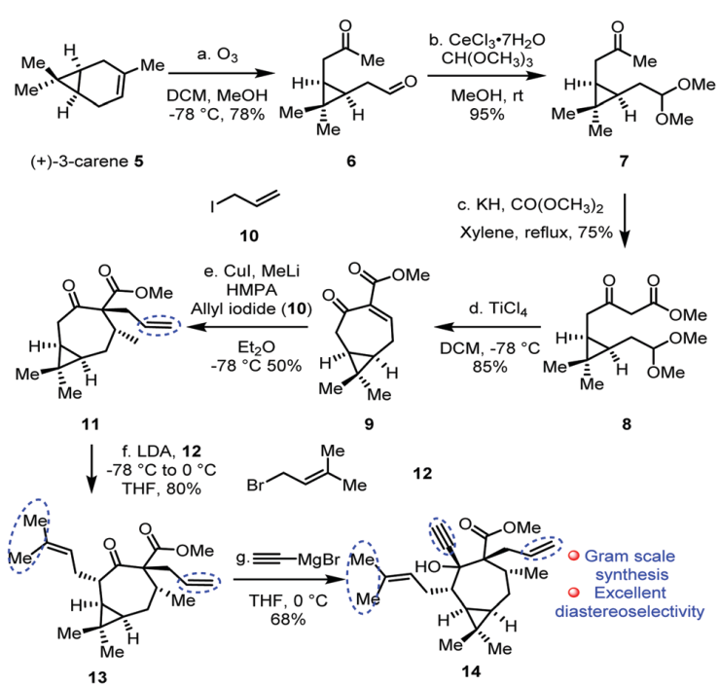
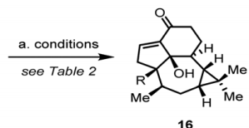
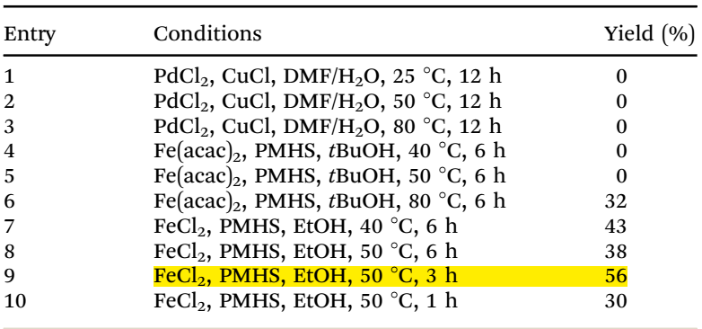
Synthesis of Euphorikanin A skeleton

Slide 12
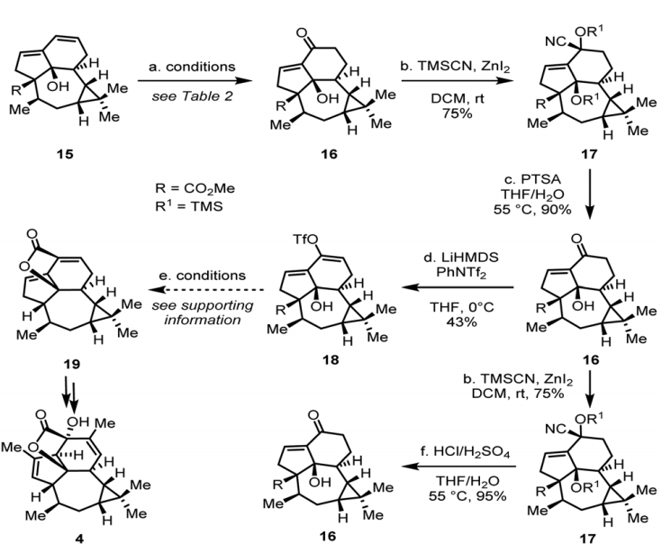
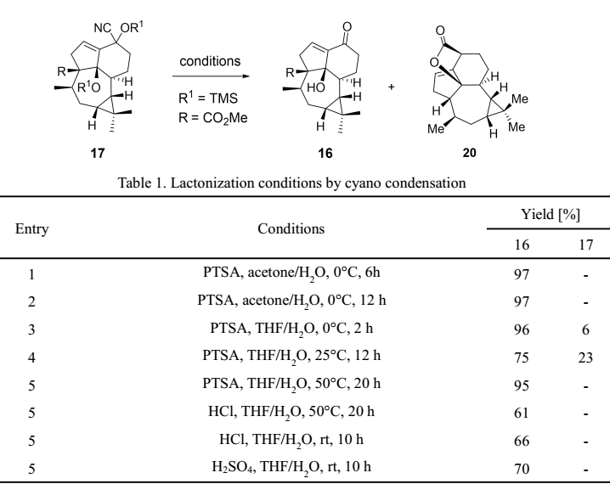
Synthesis of Euphorikanin A skeleton

Slide 13
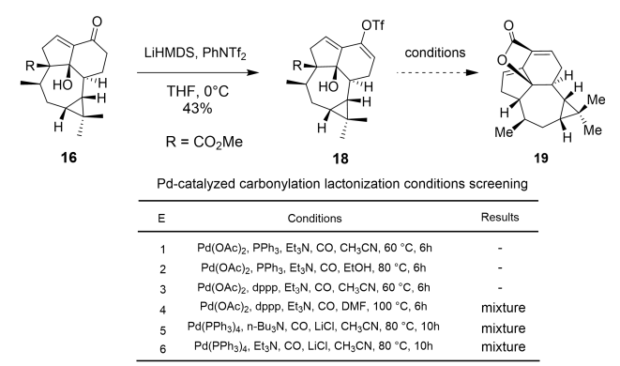
Synthesis of Euphorikanin A skeleton

Slide 14
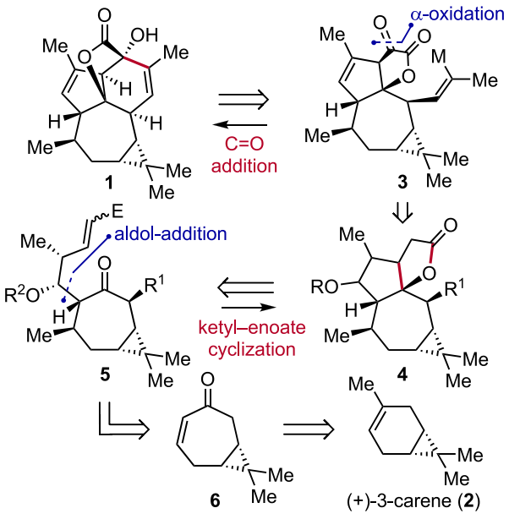
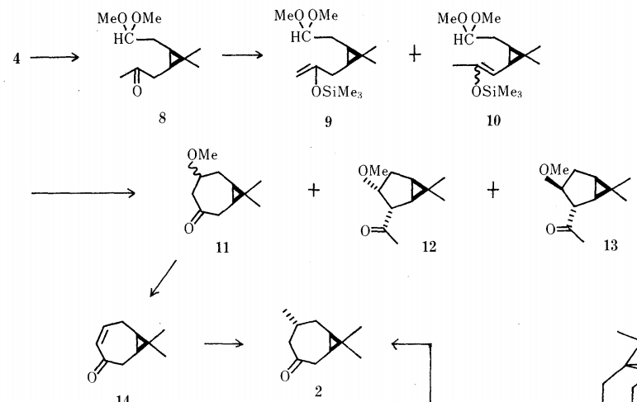
Enantioselective Total Synthesis of (+)-Euphorikanin A
Retrosynthetic Analysis
5:1

Slide 15
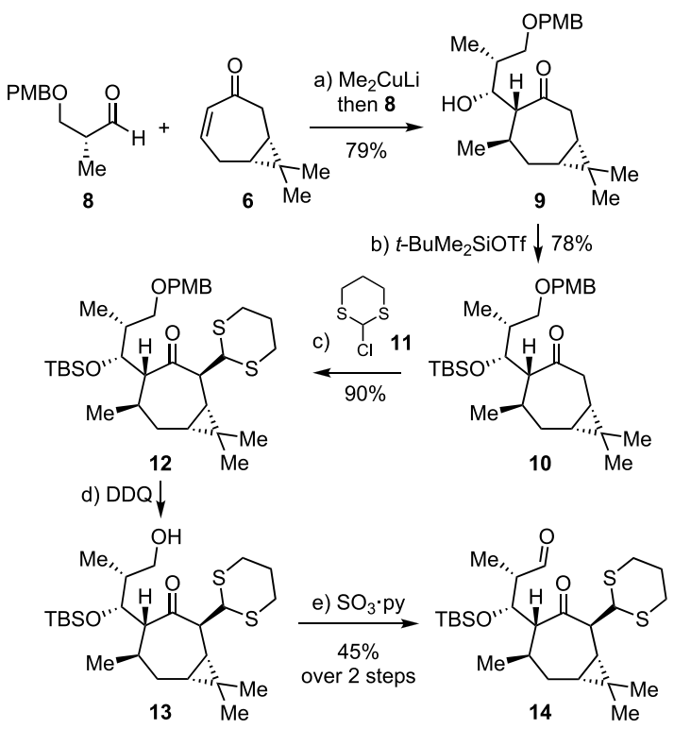
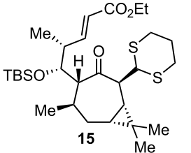
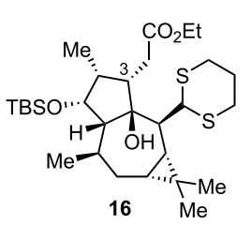
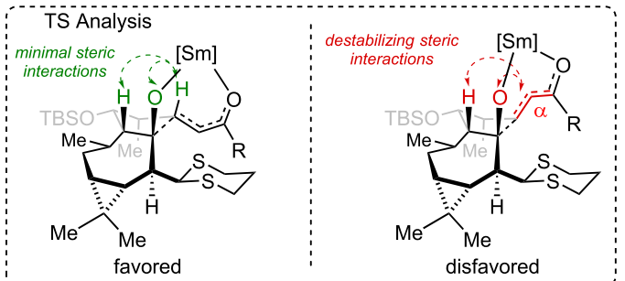
Enantioselective Total Synthesis of (+)-Euphorikanin A
HWE
SmI₂
14

Slide 16
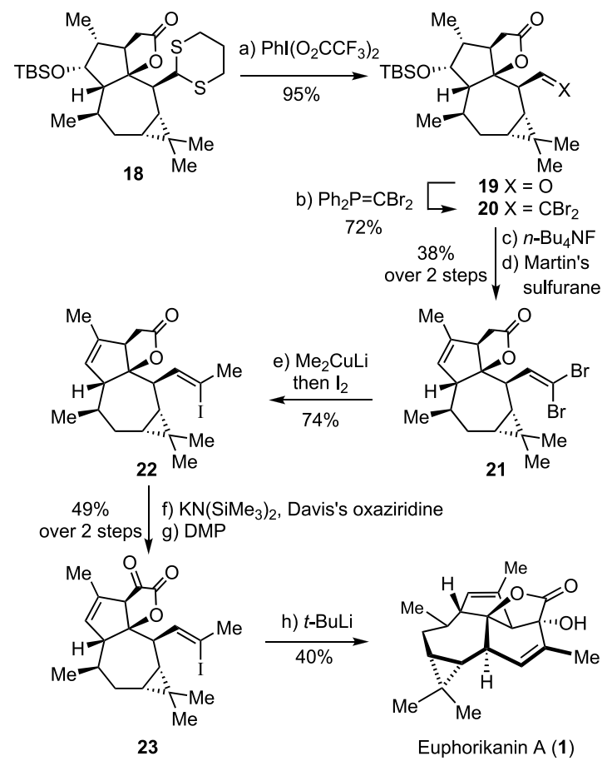
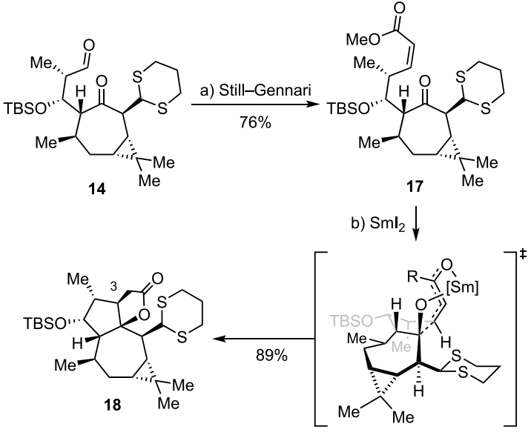
Enantioselective Total Synthesis of (+)-Euphorikanin A

Slide 17
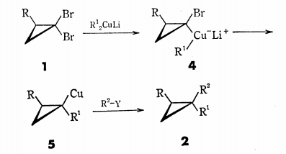
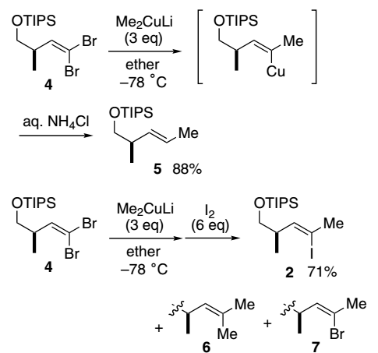
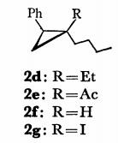
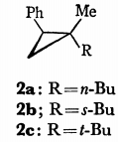
Enantioselective Total Synthesis of (+)-Euphorikanin A

Slide 18
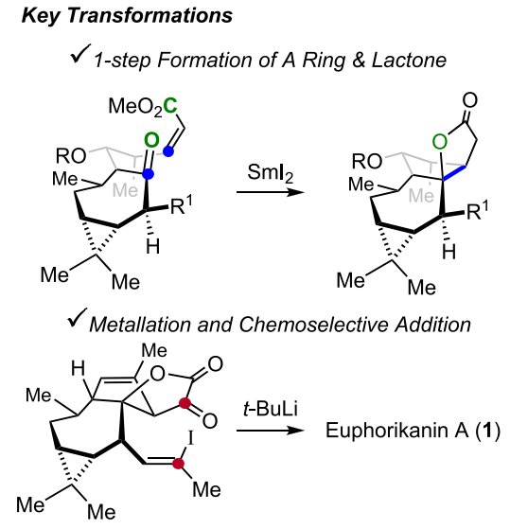
Enantioselective Total Synthesis of (+)-Euphorikanin A
First total synthesis of (+)-euphorikanin A
19 steps from (+)-3-carene

Slide 19
Thanks ！

Slide 20
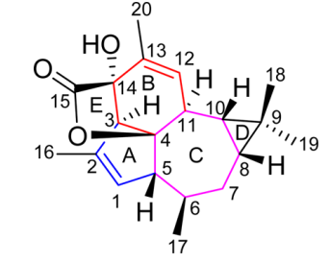
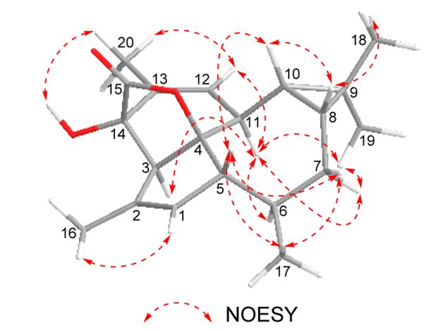
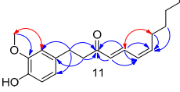
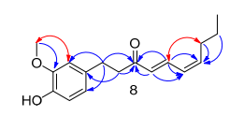
NOESY (red) correlations of compounds 8,11

